Slide 1









AI ENGINEERING FACTORY
“We don't just build AI agents.
We engineer how AI builds software.”

Slide 2













The Engineering Transformation
FRAGMENTED HANDOFFS VS. GOVERNED CONTINUOUS EXECUTION

Slide 3




The Core Operating Model
SEVEN LAYERS OF ENGINEERED EXECUTION

Slide 4





















Inside the Factory Architecture
ENTERPRISE CONTROL PLANE TO REAL EXECUTION

Slide 5








Harness is the Governance Backbone
NOTHING EXECUTES OUTSIDE THE HARNESS RUNTIME.

Slide 6








Graph Defines the Engineering Path
EXECUTION TOPOLOGY

Slide 7








When Engineering Fails — The System Recovers
ADAPTIVE RECOVERY LOOP

Slide 8





Agent Factory
FROM NATURAL LANGUAGE TO REUSABLE ENGINEERING WORKER
Payment Refactoring Agent

Slide 9


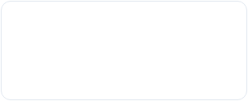
The Engineering Capability Matrix
DECOUPLING WORKERS FROM THEIR TOOLS AND INTELLIGENCE
SKILLS
TOOLS
MODELS

Slide 10
Greenfield Engineering
FROM BUSINESS REQUIREMENT TO RUNNING APPLICATION
Architecture Map
Domain Model
API Specs
Story Map

Slide 11
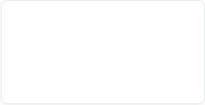



Every Story is an Engineering Contract
TEST CASES GENERATED AND APPROVED BEFORE IMPLEMENTATION
JIRA-101
TC-001: Valid registration
User Registration
TC-002: Duplicate email
TC-003: Invalid format

Slide 12







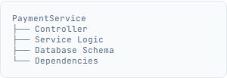
Brownfield Engineering
AI UNDERSTANDS THE EXISTING SYSTEM BEFORE CHANGING IT
JIRA-2456
"Add retry logic"

Slide 13
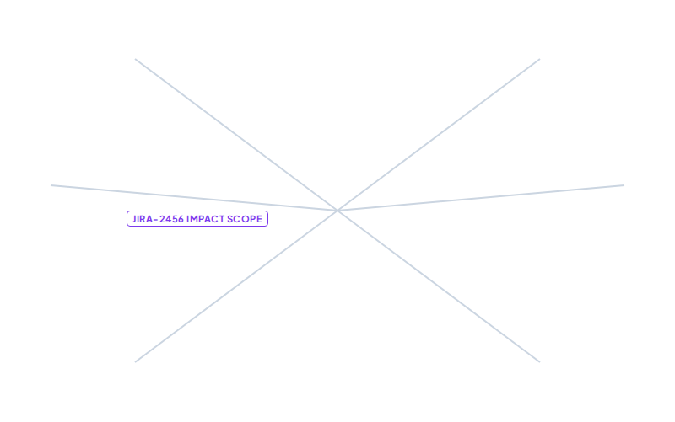







The Engineering State
THE AI REMEMBERS THE SOFTWARE, NOT JUST THE CONVERSATION.

Slide 14












Pipelines Compose Capabilities
PIPELINE = LIFECYCLE. HARNESS = GOVERNED CAPABILITY.

Slide 15


This Is Not A Simulation Layer
AI DECISIONS TRANSLATE TO ACTUAL ENGINEERING ACTIONS
$ git checkout -b feature/retry
> Switched to a new branch
$ echo "..." > PaymentService.java
$ mvn clean test
> [INFO] Tests run: 48, Failures: 0
$ git commit -m "Update retry"

Slide 16






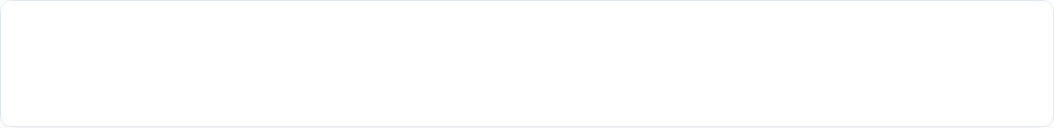
Every AI Action Produces Evidence
AI OUTPUT WITHOUT EVIDENCE IS AN OPINION. ENGINEERING EVIDENCE MAKES IT ACCOUNTABLE.
Harness ID: dev-pipeline-v4
Agent ID: coding-agent-gpt4o
Commit Hash: 9f86d081
Files Changed: 3 (PaymentService.java...)
Tests Run: 48 / 48 PASSED
SonarQube: PASSED (0 Critical)
Risk Score: LOW
Approval: AUTO-APPROVED

Slide 17










Governance by Construction
EMBEDDED INTO EXECUTION, NOT BOLTED ON AFTER.

Slide 18


Engineering Intelligence
MEASURING THE IMPACT OF THE AI ENGINEERING FACTORY
-60%
-85%
+$0.15
12%
Idea to Production
Pre-deployment bugs
Avg Token Cost per Story
Intervention Rate

Slide 19








Closed Loop Engineering
THE FACTORY CONTINUOUSLY LEARNS FROM EXECUTION.
▼
▼

Slide 20








“We don't just build AI agents.
We engineer how AI builds software.”

